Slide 1
High-accuracy prediction of raw material prices using deep learning approach

Slide 2
Agenda
Assignment & challenges
Project pipeline
Gathering data
Data preparation and analysis
Models comparison
Results
Demo with open-source crude oil prices dataset

Slide 3
Assignment & challenges

Slide 4
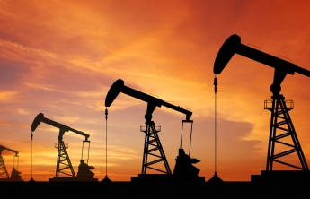
Client: international plastic pipe supplier
Raw plastic material price prediction for 2 months ahead
Help procurement management team
Stack: python, Azure, Docker, SAP

Slide 5
Predicting future prices…

Slide 6
Project pipeline

Slide 7
Business understanding
Data collection
Data preparation and analysis
Train and evaluate model
Visualize the results

Slide 8
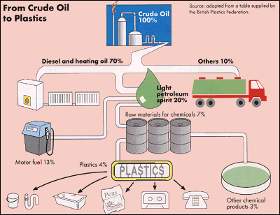
Problem understanding
Diving into the domain

Slide 9
Data collection

Slide 10


Slide 11
→ Set a brainstorm session with a client to find out the most important price drivers.

Slide 12
Mindmaps approach
Business understanding
What price drivers are really important?
Volatility factor
Availability factor

Slide 13
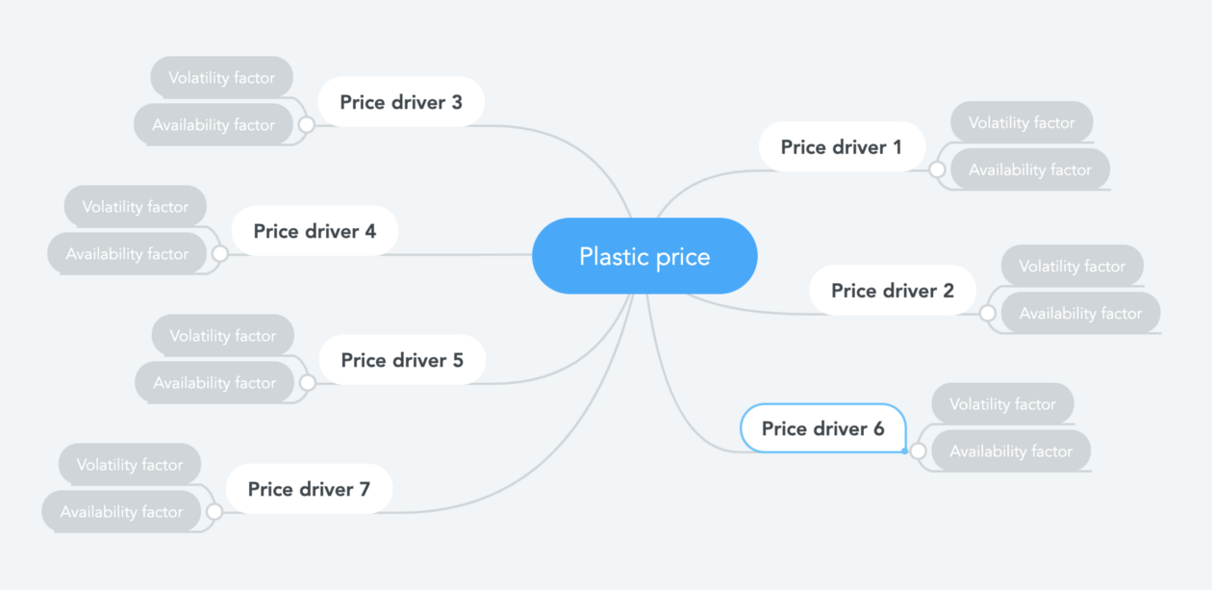

Slide 14
Price drivers we used for the current project:
Supply/demand factors
Crude oil prices
Import/export values
Business climate index
Economic and manufacture indexes

Slide 15
Data preparation and analysis

Slide 16
→Data were collected on a monthly basis.
→ Dataset was splitted into train dataset (in-sample data) and test set.
→ The data units and scales are vastly different. So all the independent variables were normalized (min-max normalization) to be between 0 and 1

Slide 17
Time-series data
→ Is it stationary?
→ Is there a seasonality?
→ Is the target variable autocorrelated?

Slide 18
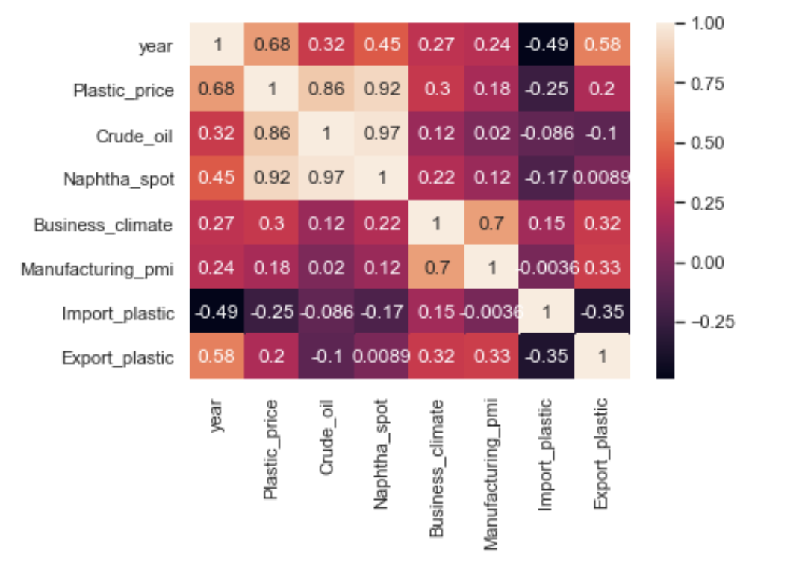
Correlation heat map

Slide 19
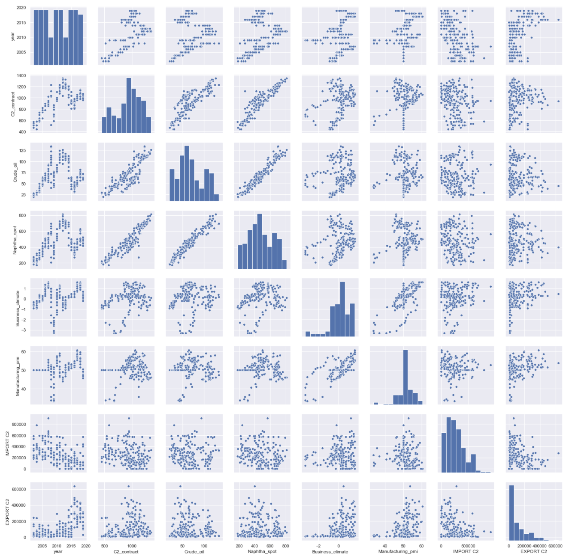
Tools that are handy to use: Seaborn library

Slide 20
Models comparison

Slide 21
Multiple linear regression
multiple independent variables
tend to overfit as the number of independent variables increase

Slide 22
Auto-Regressive Integrated Moving Average (ARIMA)
information in the past values of the time series can alone be used to predict the future values.
is characterized by 3 terms: p, d, q
p is the order of the AR term
q is the order of the MA term
d is the number of differencing required to make the time series stationary

Slide 23
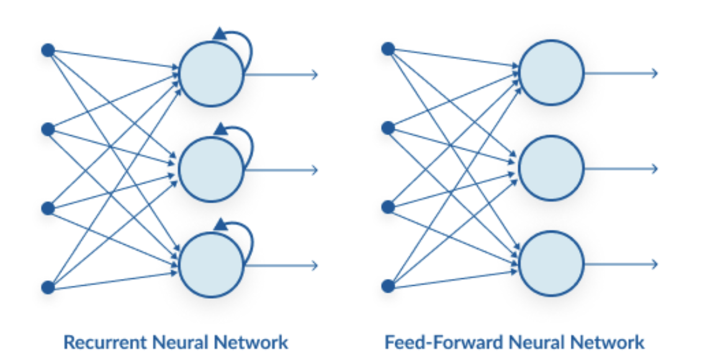
Neural Network and Recurrent Neural Network

Slide 24
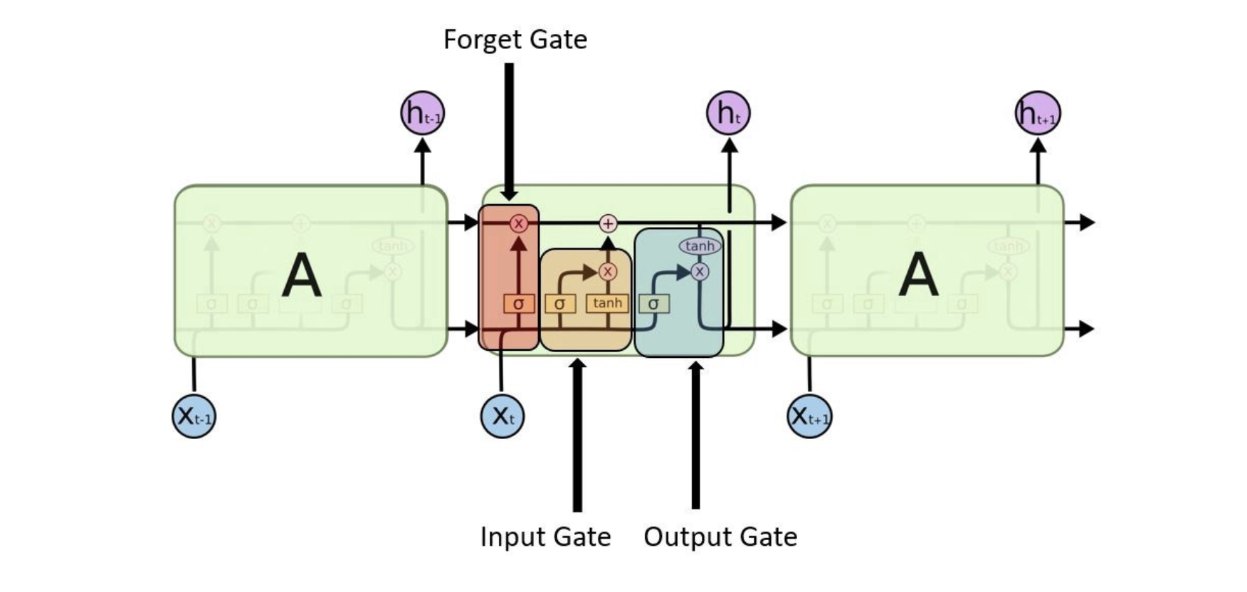
Long Short Term Memory (LSTM)

Slide 25
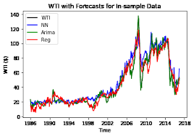
Regression vs ARIMA vs NN
*Natarajan et al. arXiv, 2018

Slide 26
Results

Slide 27

Tools and deployment

Slide 28
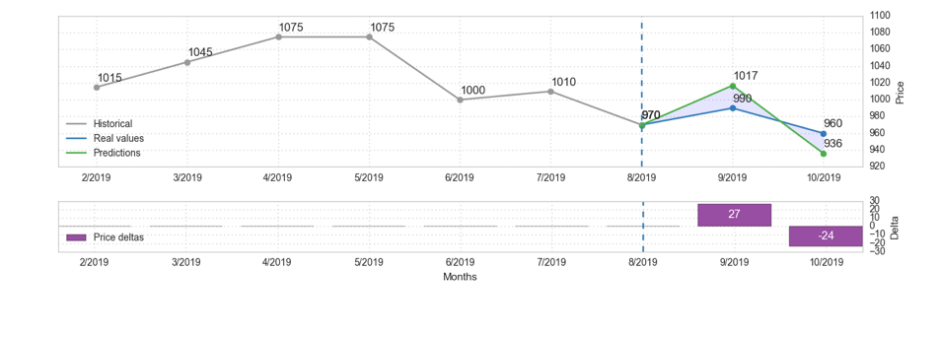
Visualization
Accuracy > 90%

Slide 29
Demo

Slide 30
Thank you!
Nataliya Zhovannik
Linkedin:linkedin.com/in/nataliyazhovannik/
Github: github.com/inspirenata
Twitter: @inspire_nata

